Slide 1


By Wilfred Bos
20 February 2021

Slide 2
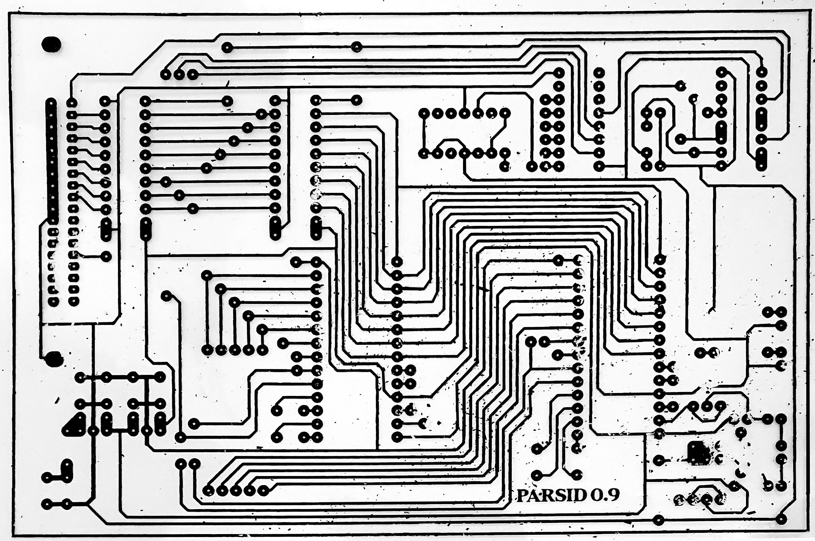
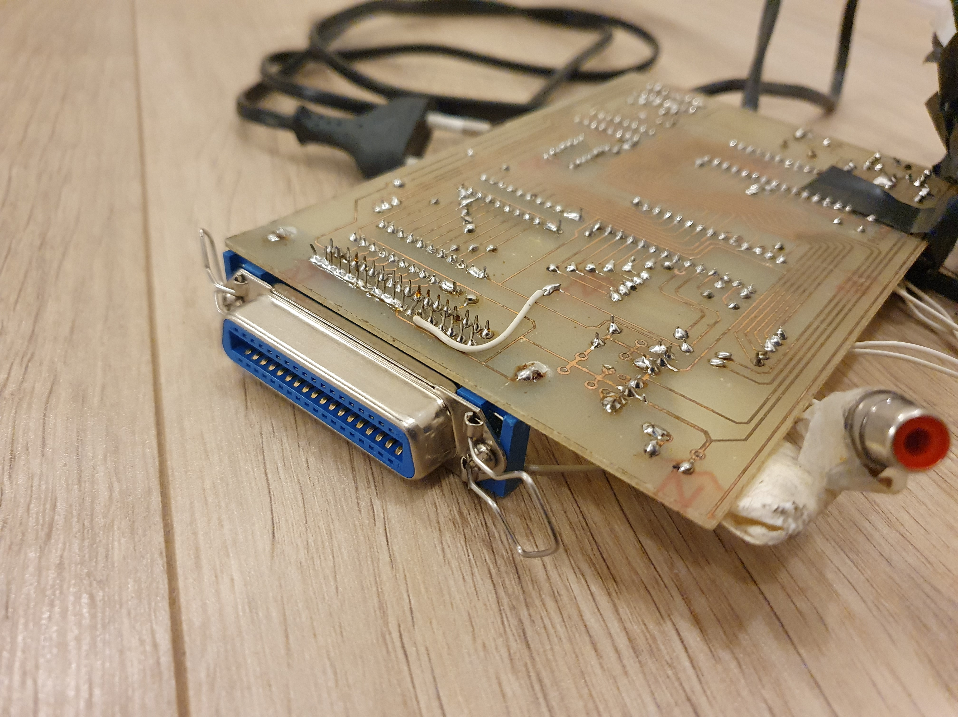
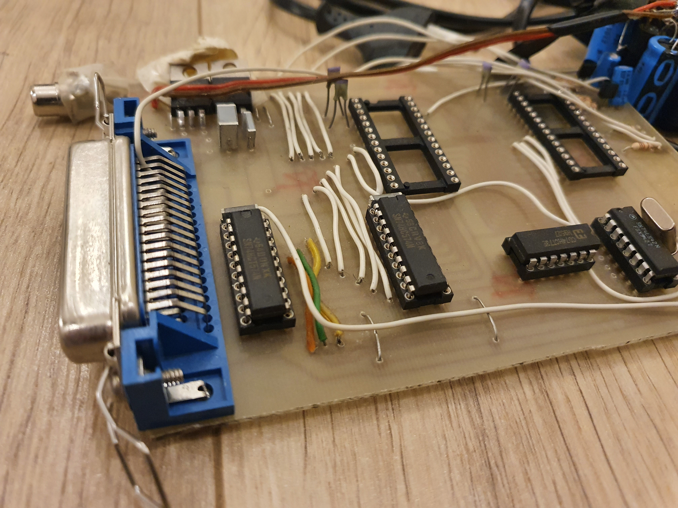
Started in 1995
In assembly for DOS

Slide 3
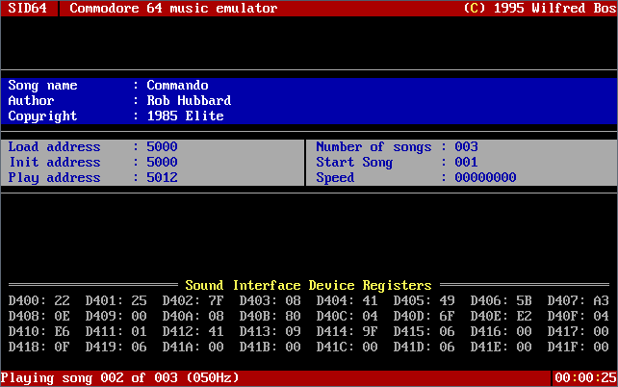
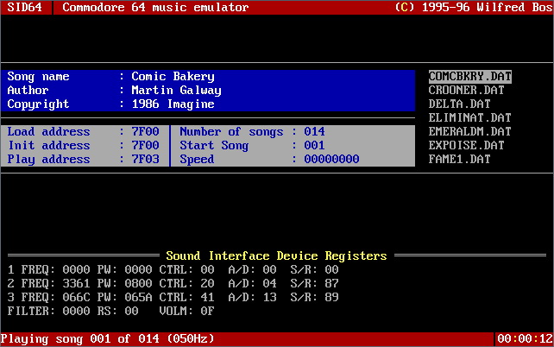
SID64

Slide 4
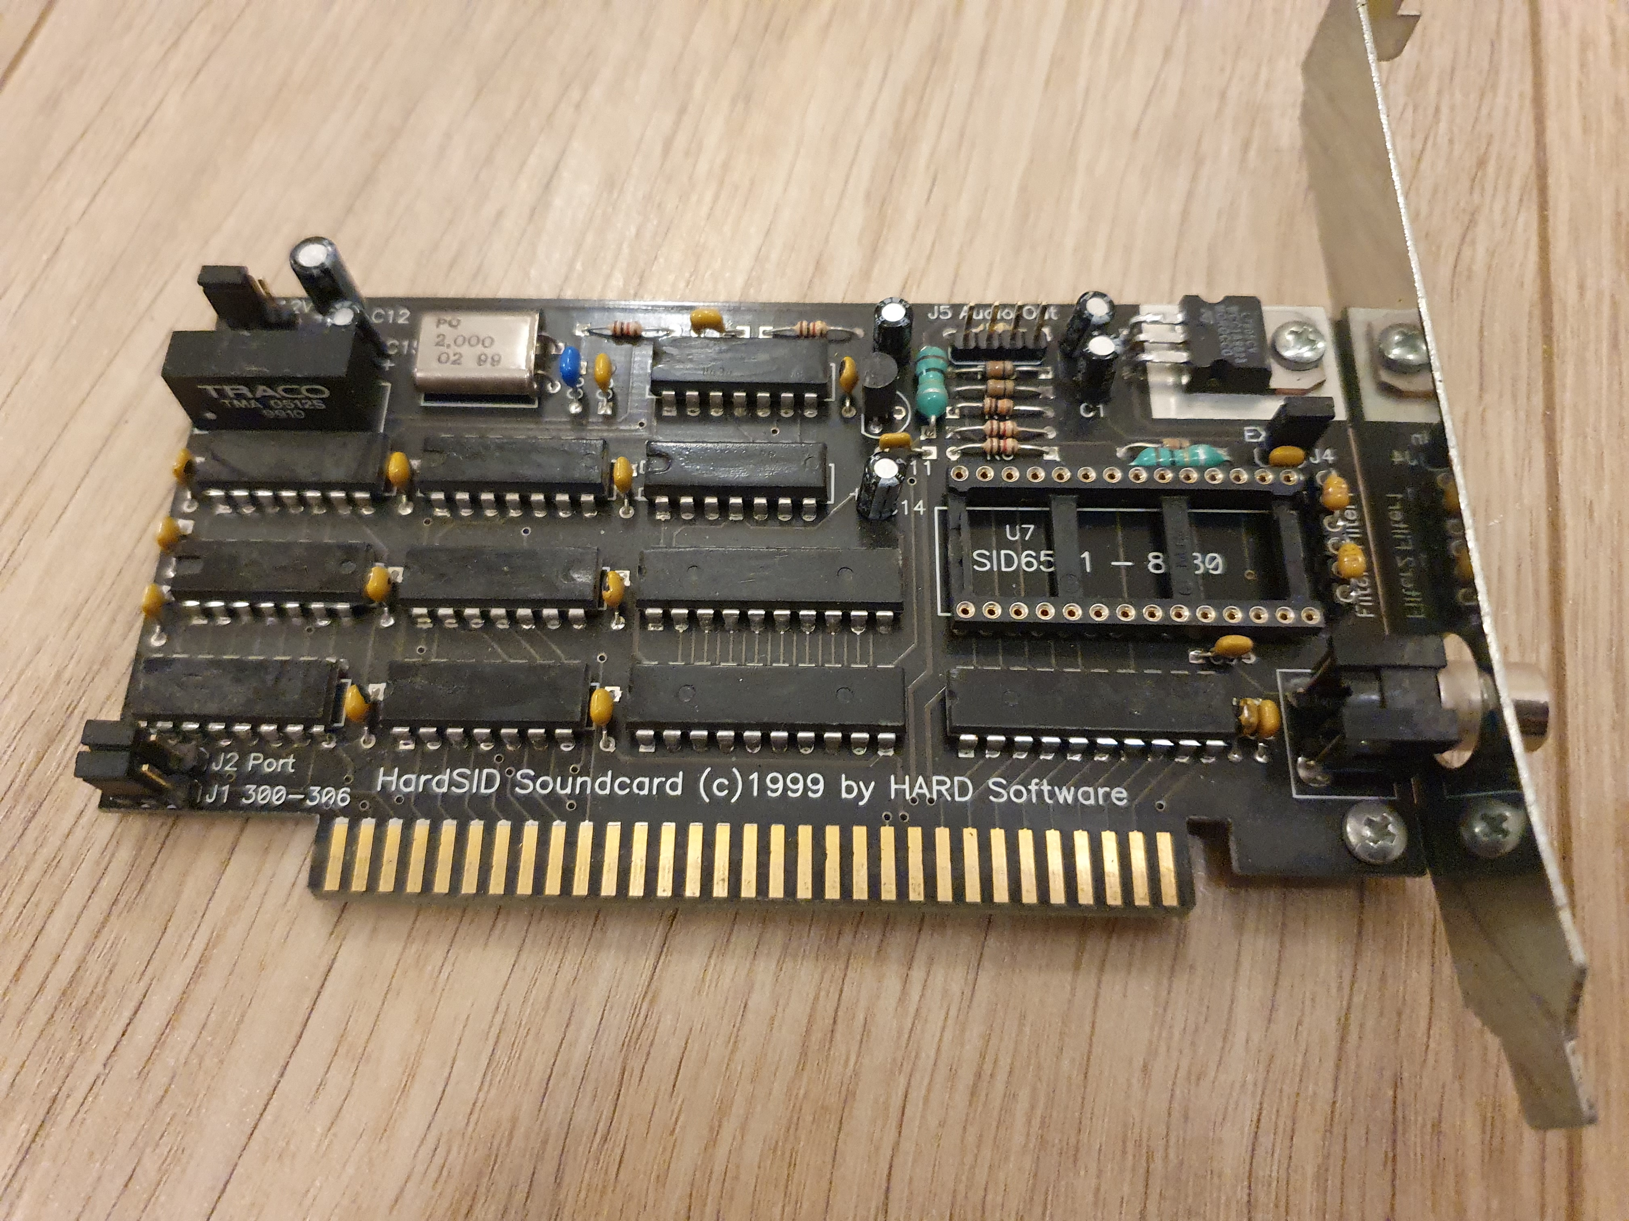
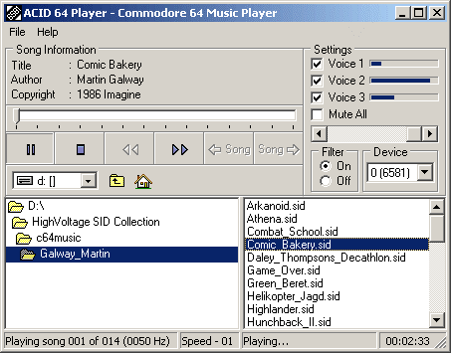
2003
First release of ACID64
1999

Slide 5
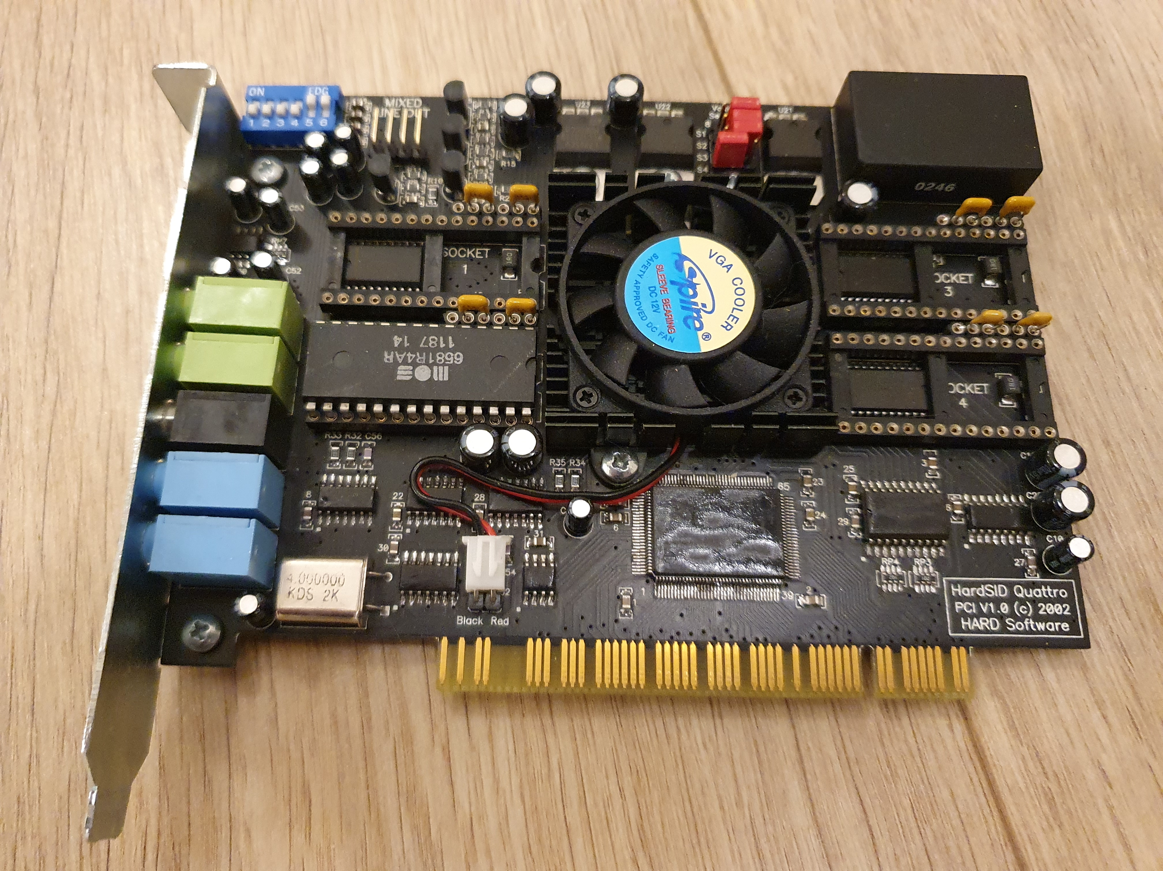
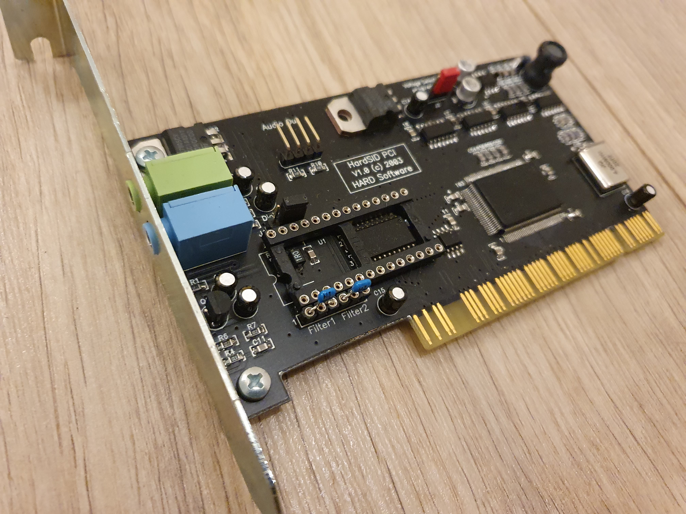
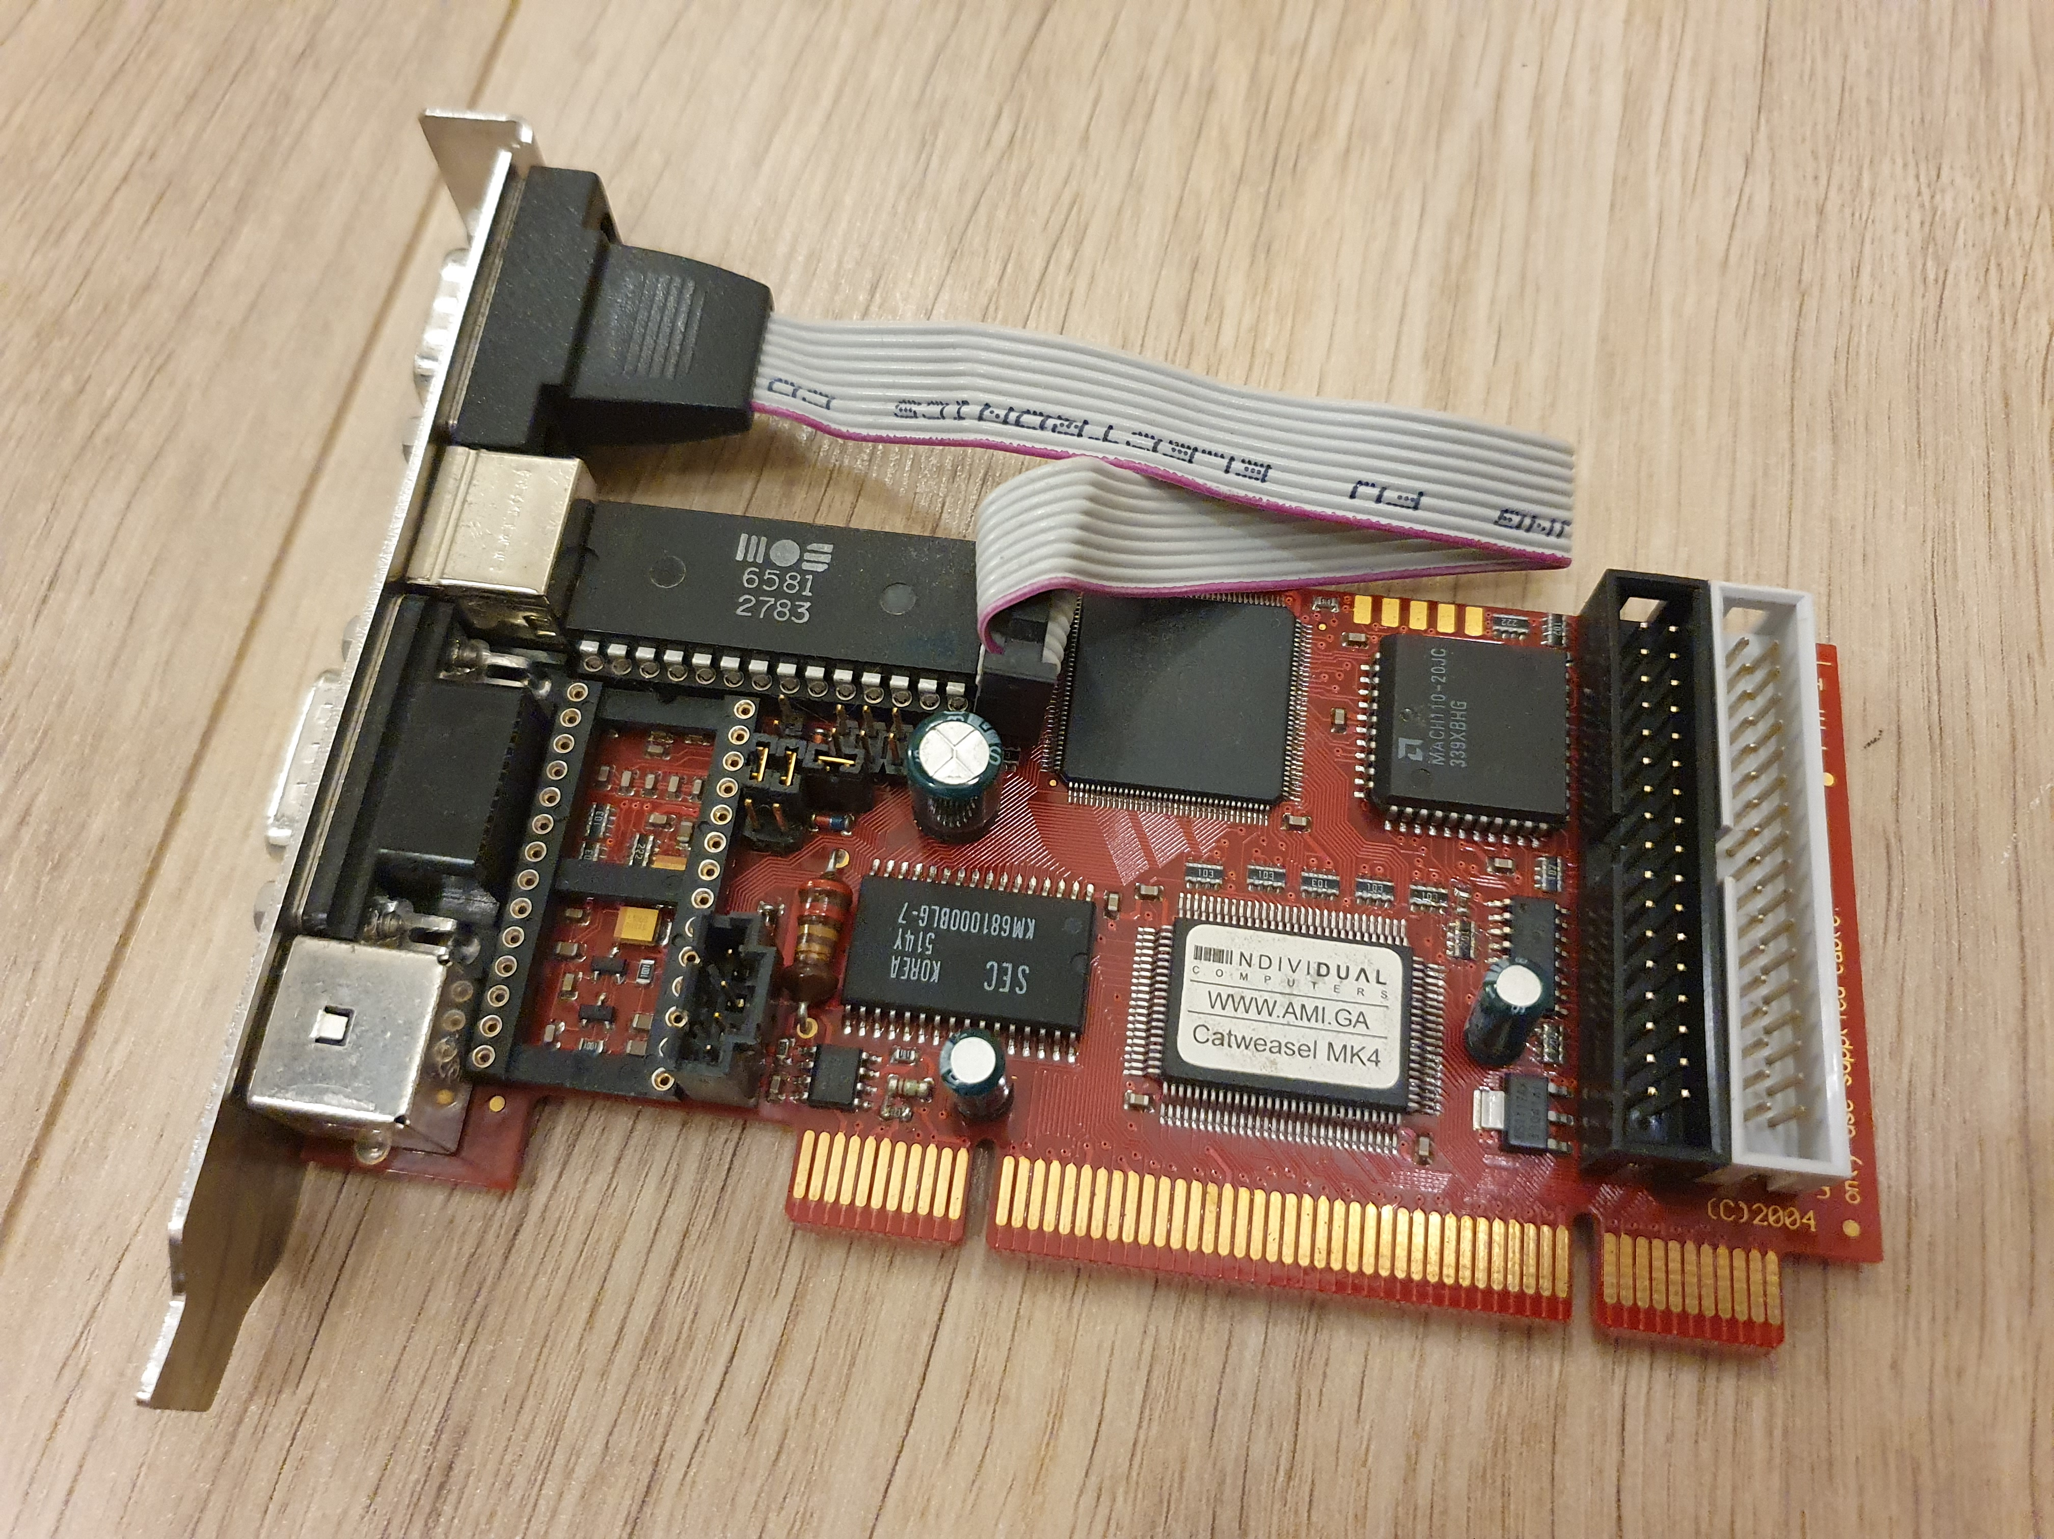
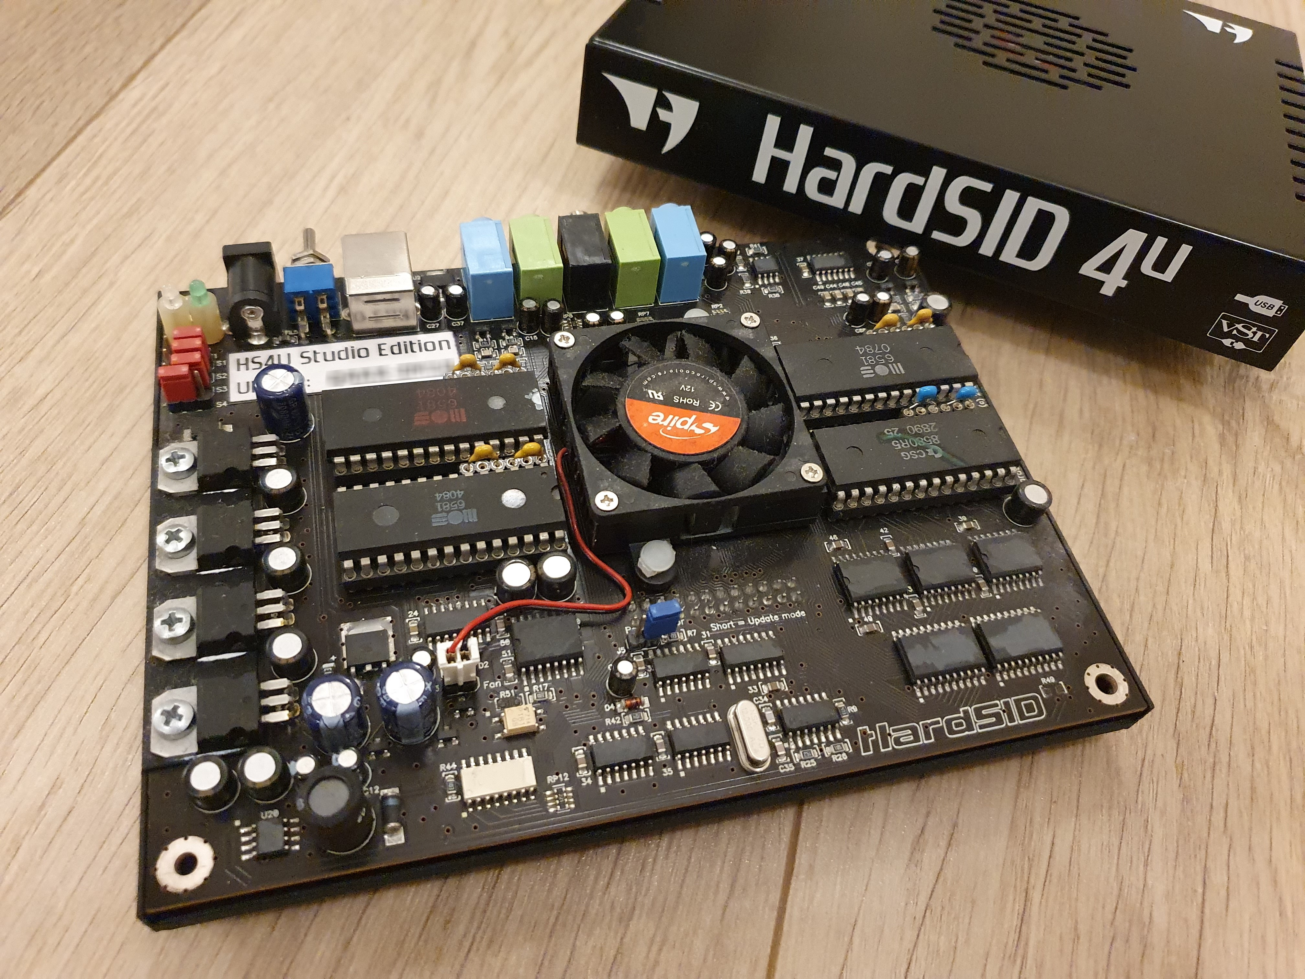
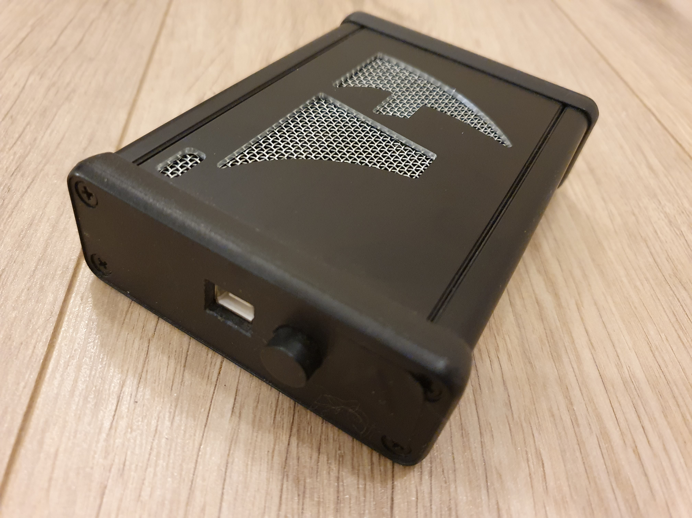
2002
2003
2004
2008
2008
2009

Slide 6
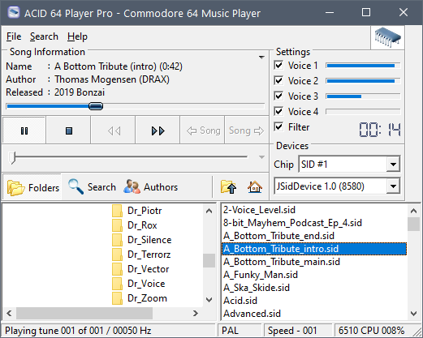


Slide 7
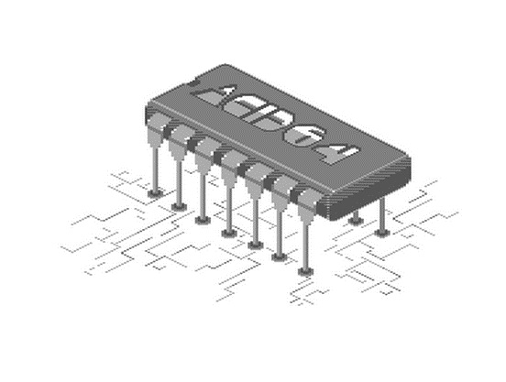
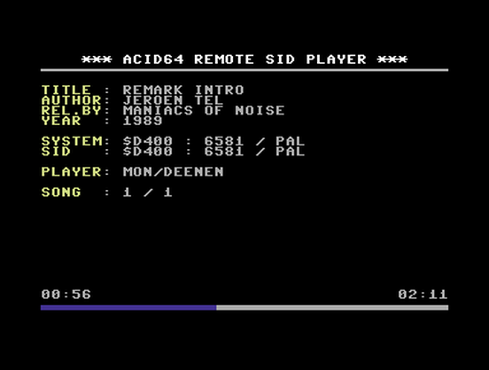
Remote SID Player
For 1541 Ultimate and
Ultimate 64

Slide 8





Requirements

Slide 9








ACID64 V4.0
Development started in February 2019
UI development started in November 2019

Slide 10
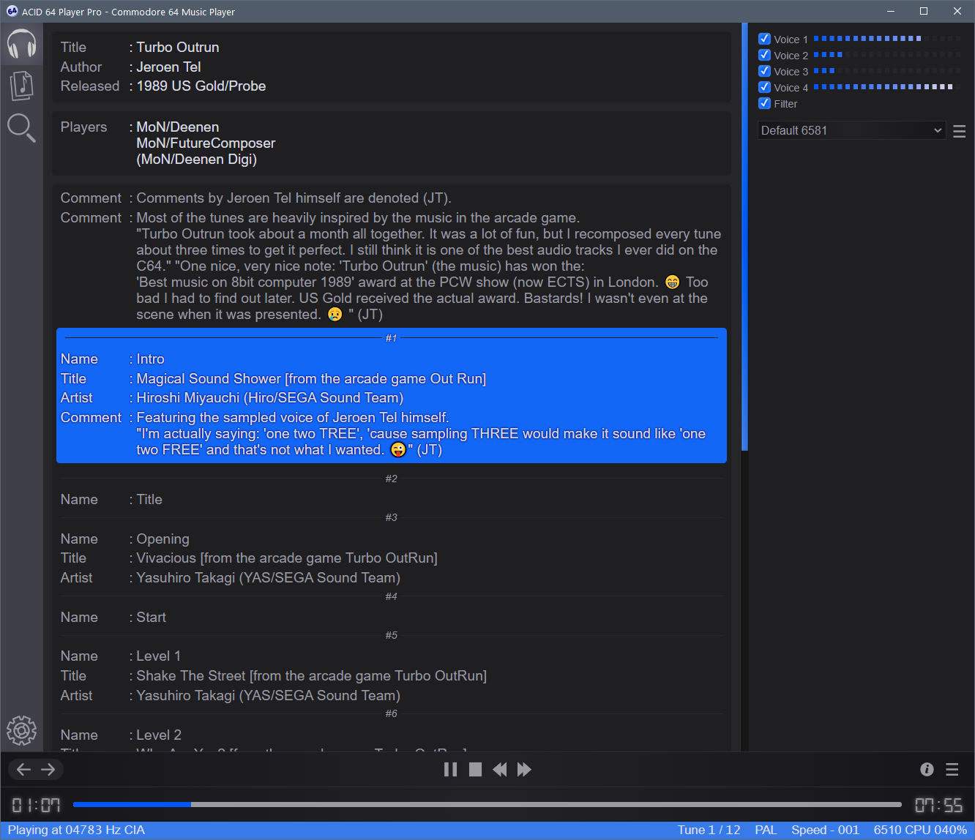
Demo Time

Slide 11
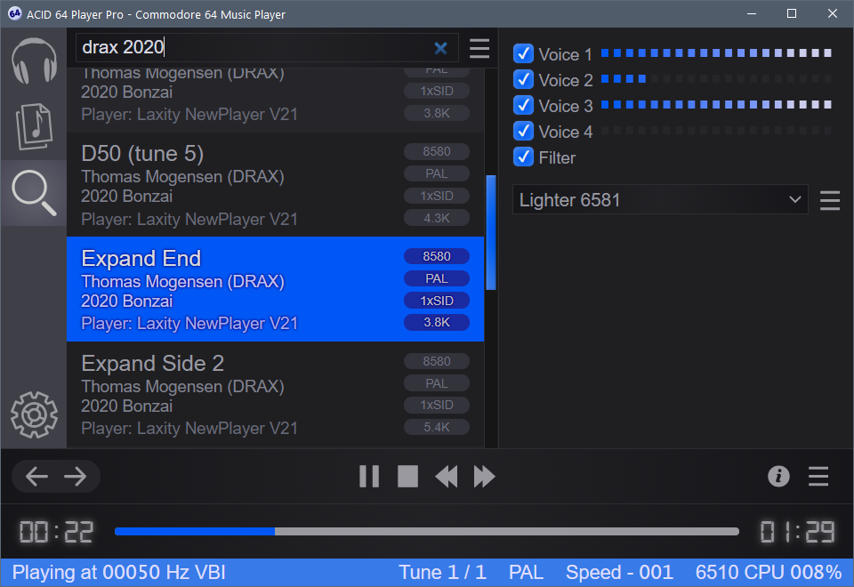
Architecture
ACID64 Library
Indexing Thread
Network SID Device
Player ID
HVSC Search
Player
Player Thread
HardSID USB
Read Folder Process
Main Process
IPC
IPC

Slide 12


